Slide 1

INCOME DISTRIBUTION ANALYSIS
STATISTICS
PCI - Per Capita Income.

Slide 2
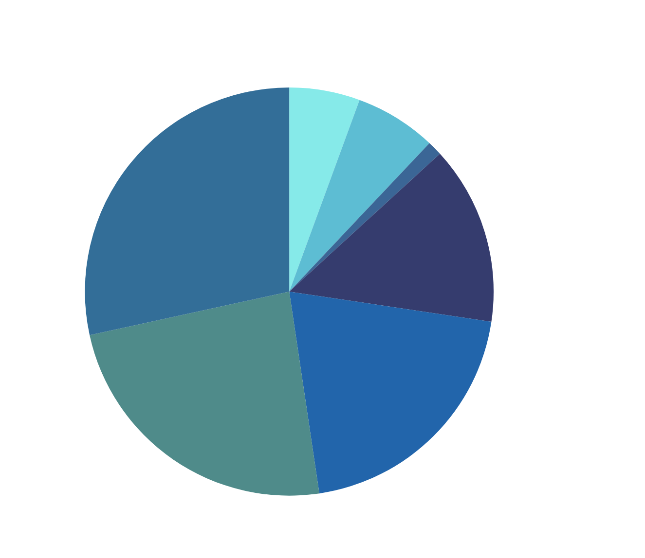


This data has been sourced from the existing database of the International Monetary Fund.
INCOME DISTRIBUTION
(AMONG COUNTRIES)

Slide 3

INCOME DISTRIBUTION
(AMONG COUNTRIES)
INDIA
CHINA
RUSSIA
SAUDI ARABIA
NEW ZEALAND
GERMANY
AUSTRALIA
COUNTRY
PCI
$2698
$12969
$14953
$32881
$47072
$55521
$65966

Slide 4

MEAN:
Statistical analysis of income distribution examines how income is spread across a population using measures like mean and median.
MEAN =∑X/N
MEAN =723106
MEAN =33,151.43

Slide 5
MEDIAN:
Statistical analysis of income distribution examines how income is spread across a population using measures like mean and median.
Ordered values:
2698, 12969, 14953, 32881, 47072, 55521, 65966
Median = Middle value = 32,881

Slide 6
MODE:
2698, 12969, 14953, 32881, 47072, 55521, 65966
Since all values are unique (each appears only once), there is no mode in this dataset.
Reason:
Mode represents the most frequently occurring value, but since no PCI value repeats, the dataset is mode-less.
(no mode)

Slide 7
STANDARD DEVIATION (SD):
Inequality in income distribution can be measured using Standard Deviation (SD), where a higher SD indicates greater income disparity.
σ = 21,879.78

Slide 8
ANALYSIS AND CONCLUSIONS:
Mean (33,151.43) represents the average PCI but is influenced by extreme values.
Median (32,881) is the middle value, offering a better central measure when data is skewed.
Mode does not exist as all PCI values are unique.
Standard Deviation (21,879.78) indicates high income disparity among the countries.
STATISTICS

Slide 9

THANK
YOU....
-SAKTHI SUSMITHA
-ANNIE JUDITH
-AVANTHIKA
-ANUPRIYA
-BRINDHA

